Slide 1
ANDROIDIC ARM
Presented by :
Neha Gour
B.Tech 7sem (ECE)

Slide 2
CONTENTS
Embedded system
Robotic system
Use of Robotics
Robotic arm
Mechanical aspects
Electrical aspects
Controlling
Characteristics of Bluetooth
Application of Androidic arm
Conclusion
References

Slide 3
EMBEDDED SYSTEM
What is the System?
A system is also an arrangement in which all its units assemble and work together according to the plan or program.
or
A system is a way of working, organizing, or doing one or many tasks according to a fixed plan or program.
What is Embedded?
To insert something inside.
or
To implant something inside.

Slide 4
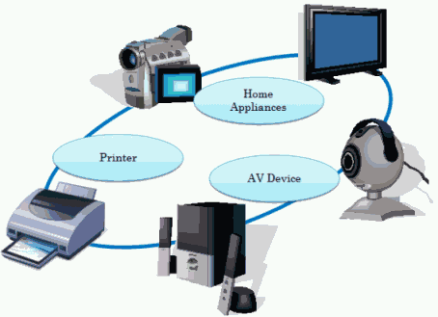

Slide 5
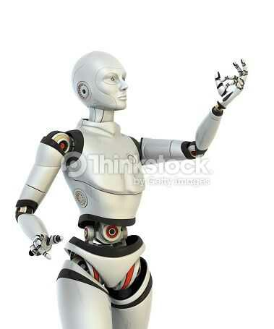
ROBOTIC SYSTEM
Robotics is defined as Man-made mechanical devices that can move by themselves, whose motion must be modeled, planned, sensed, and controlled, and whose motion can be influenced by “PROGRAMMING”.

Slide 6
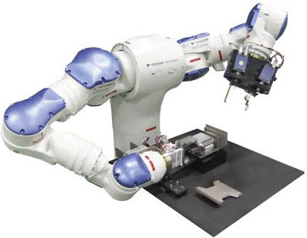
USE OF ROBOTICS
Robots are primarily used for
Precision work
Repetitive work
Dangerous work
Exploration
Competition
Future Manufacturing

Slide 7
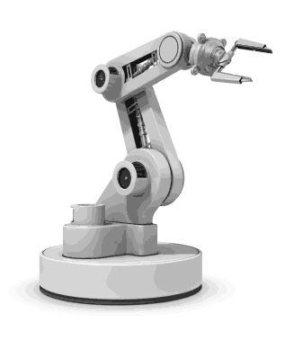
ROBOTIC ARM
A robotic arm is a mechanical arm this is similar to a human arm. The arm may be the part of the robot. performed any desired task like welding, spinning, etc.

Slide 8
MECHANICAL ASPECTS
Four motors of the movement of the arm.
Rectangular box used as a base.
Arm is made up of an Aluminum bar.
Wireless controlling circuit assembled.

Slide 9
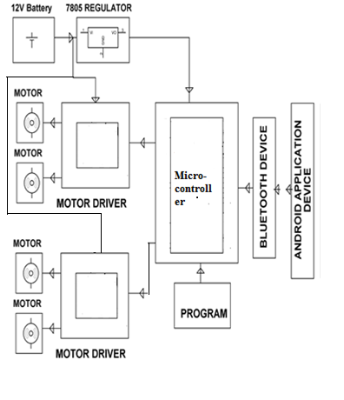
ELECTRICAL ASPECT

Slide 10

CONTROLLING
Arm is controlled wirelessly by serial communication through an Android device. We have controlled the different movements of the arm by Android device through Bluetooth.

Slide 11
CHARACTERISTICS OF BLUETOOTH
Frequency - 2.4 GHz.
Range - 10 meter.
Data transfer rate - 800 kbps.
Power consumption -5 MW.
Usage location - Anywhere at least two Bluetooth device ideal.
Primary device - mobile phone, consumer electronics, offices.

Slide 12
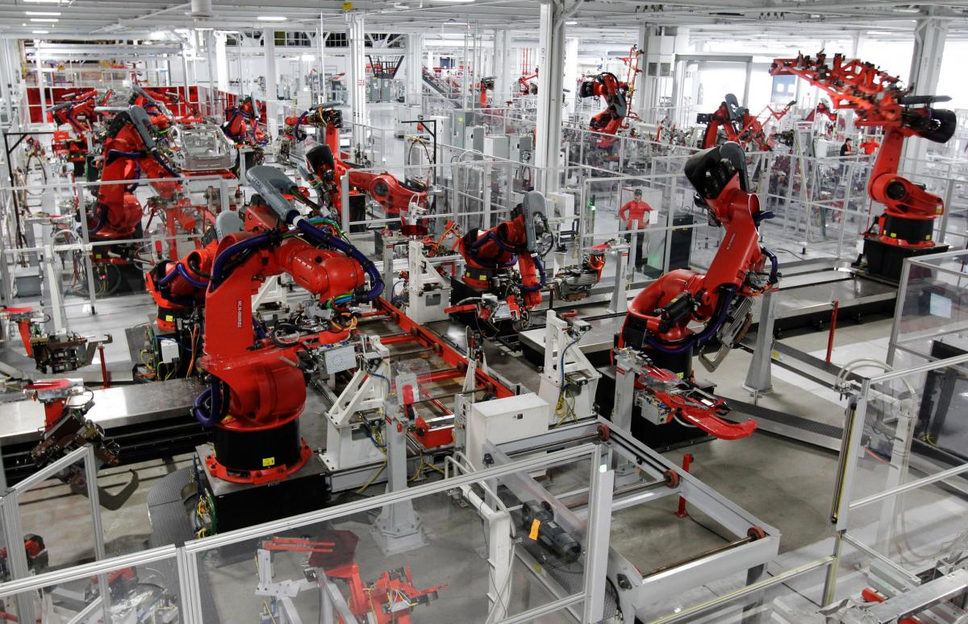
Application of robotic arm flexible automation

Slide 13
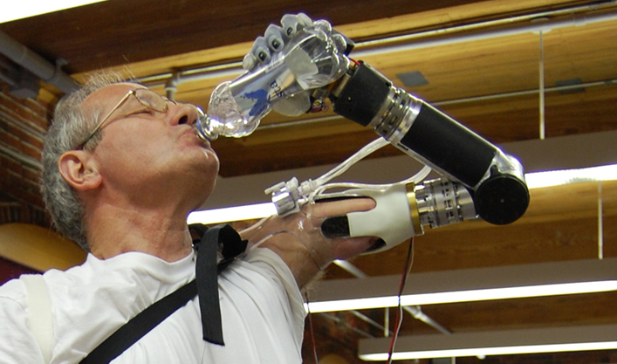
as artificial arm

Slide 14
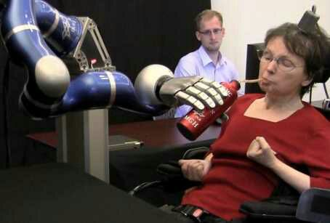
As third arm

Slide 15
FUTURE SCOPE
We can replace the control with Bluetooth to the wi-fi.
DC motors can also be replaced by Servo motors in the future.

Slide 16
CONCLUSION
Pick and place operation is successfully designed and developed.
The arm can easily pick up the object and place it effectively using the Android system.

Slide 17
REFERENCES
http://www.oledcomm.net
http://www.authorestream.com
http://www.techtarget.com
http://Technology.webcrowler.com

Slide 18


Slide 19


